Slide 1

An Introduction to
Test Data Generation
David Sietz
Data Architect
Reference Material
https://github.com/dsietz/test-data-generation

Slide 2
1
overview
2
Rust
3
Markov Decision Process
4
machine learning

Slide 3
1
overview
2
Rust
3
Markov Decision Process
4
machine learning

Slide 4
a need for test data
Development
Lifecycle
Testing
Defining
Designing
Building
Planning
Deployment
Testing

Slide 5

a need for test data
Security
smoke
Integration
UAT
Ad-hoc
service
Acceptance
{ Unit }
Static
data
API
usability
Regression
Stress
Beta
automated

Slide 6
a need for test data
prepare data source
prepare tests
prepare test data
execute tests
analyze test results
concluding tasks

Slide 7
test data needs
realistic
timely
subsets
repeatable

Slide 8




realistic
variety
size
complexity
Profile

Slide 9

timely
test
reset
retest

Slide 10
subset of data
copy database
test database

Slide 11
repeatable
copy database
test database

Slide 12

test data management
How do we get our test data?
prod database
test database
application
tests
import and cleanse
time consuming
security risk
continuous integration

Slide 13

test data management
Test Data Generation
TDM database
prod database
timely
sample and cleanse
subset of data
repeatable
realistic
TDM
How do we get our test data?
test database
application
tests

Slide 14

test data generation
prod database
sample
data sample parser
data algorithm

Slide 15
test data management
TDM database
timely
subset of data
data algorithm
repeatable
realistic
data sample parser
TDM
test database
data populator
application
tests

Slide 16
test data generation
data sample
data sample parser
data algorithm
data sample parser
test data
data algorithm

Slide 17
test data generation
data sample
data sample parser
data algorithm
small light-weight library
test data
incorporate machine learning
data sample parser
process high volume of data facts
data algorithm
fearless concurrency
fast

Slide 18

test data generation
dynamic algorithms
machine learning
light weight, fast implementation
Rust

Slide 19
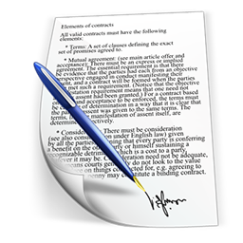

disclaimer
Not expert in Machine Learning
disclaimer
Not expert in Rust language

Slide 20

disclaimer
GO
knowledgeable
knowledgeable
Rust
machine learning
depth
subject matter expert
subject matter expert
breadth

Slide 21
1
overview
2
Rust
3
Markov Decision Process
4
machine learning

Slide 22
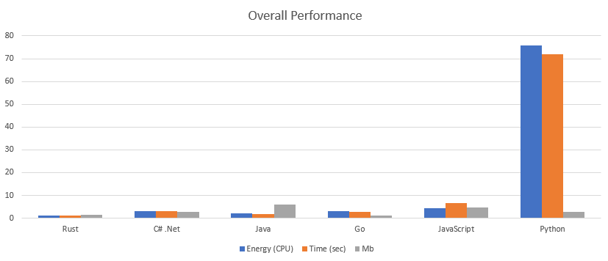
Rust
Reference:
https://jaxenter.com/energy-efficient-programming-languages-137264.html
https://benchmarksgame-team.pages.debian.net/benchmarksgame/
https://greenlab.di.uminho.pt/wp-content/uploads/2017/09/paperSLE.pdf

Slide 23
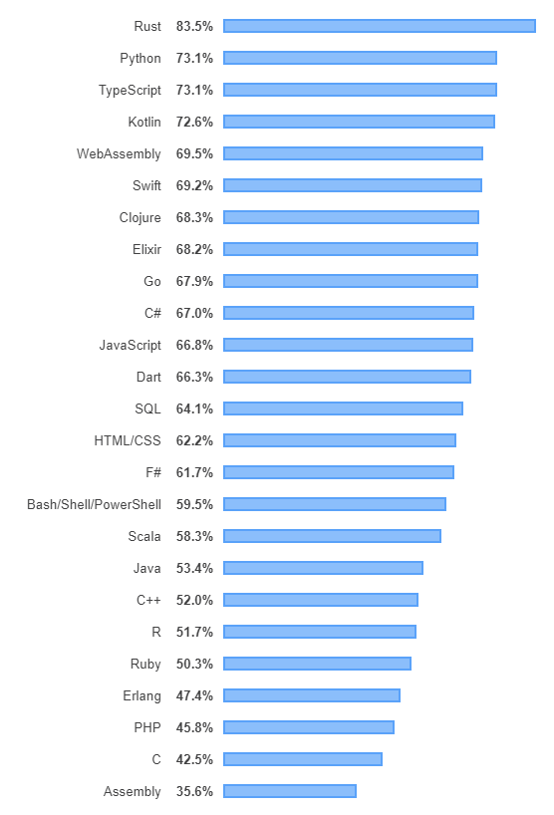
Rust
“For the fourth year in a row, Rust is the most loved programming language among our respondents, followed close behind by Python, the fastest-growing major language today. This means that proportionally, more developers want to continue working with these than other languages.”
- Developer Survey Results 2019
Reference:
https://insights.stackoverflow.com/survey/2019#most-loved-dreaded-and-wanted

Slide 24
Rust Toolchain
small and light-weight (no runtime environment required)
high performance
mature libraries
community support
concurrency (multi-threading)
map/reduce
futures (promises)
integrated testing and documentation
built in library publishing

Slide 25

Rust
“Rust is a systems programming language that runs blazingly fast, prevents segfaults, and guarantees thread safety.”
- www.rust-lang.org

Slide 26
Rust Tools
Tool | Description
Rustup | The toolchain installer
Rustc | Compiler
Cargo | Library manager

Slide 27
Rust Resources
Resource | Description
www.rust-lang.org | Homepage Documentation Installation Community
Crates.io | Crate registry
Docs.rs | Crate documentation

Slide 28

Rust Projects
Create a new project using the cargo new command.
  --bin binary program
  --lib library

Slide 29
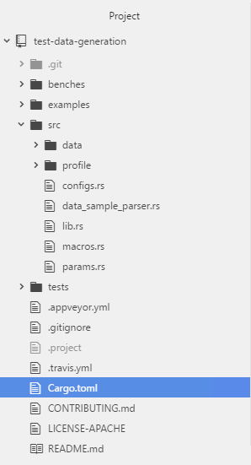
Rust Projects
Directory / File | Description
Cargo.toml | manifest for package
src | directory for source code
src / lib.rs | default library file
src / main.rs | default executable file
src / bin | directory for other executable files
tests | directory for integrated tests
examples | directory for examples
benches | directory for benchmarks

Slide 30
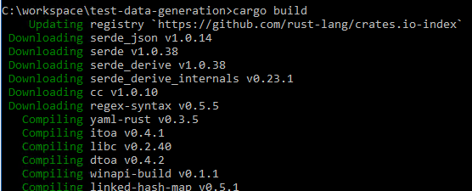
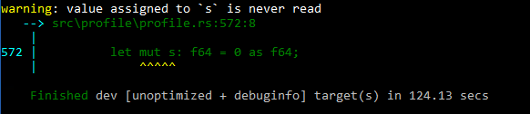
Rust Builds
Build a project using the cargo build command.
NOTE: fetches all dependencies and builds them with project

Slide 31
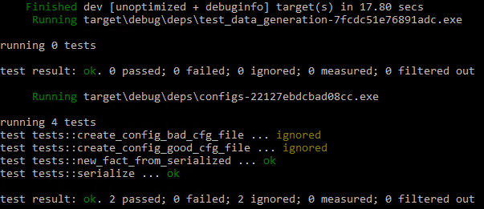

Rust Tests
Test a project using the cargo test command.

Slide 32
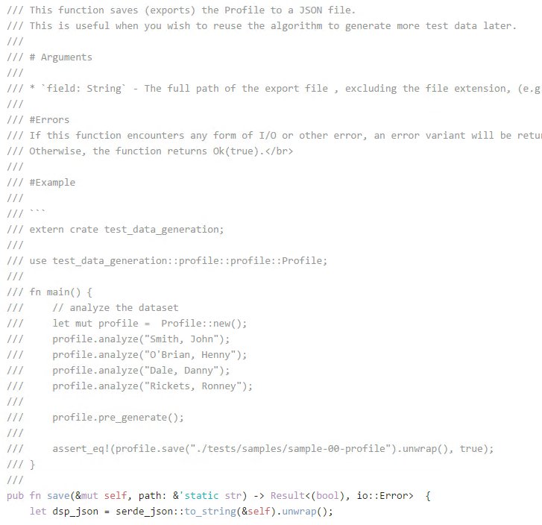
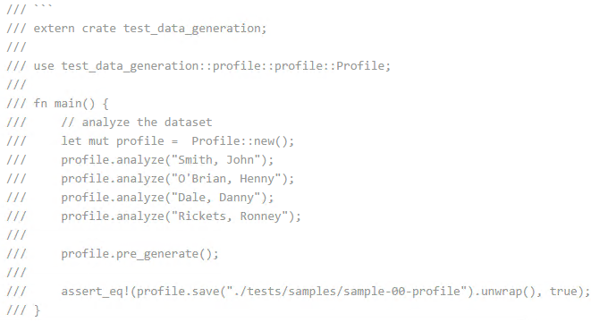

Rust Tests
NOTE: Any examples in the documentation is also tested

Slide 33
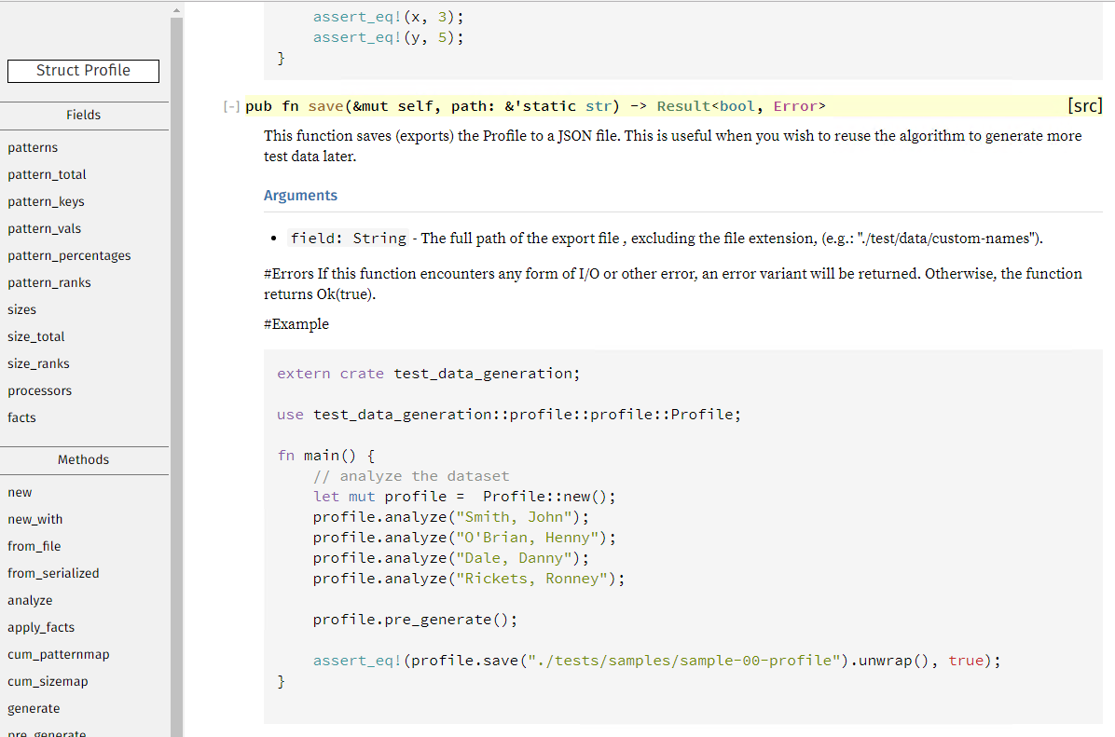
Rust Documentation

Slide 34
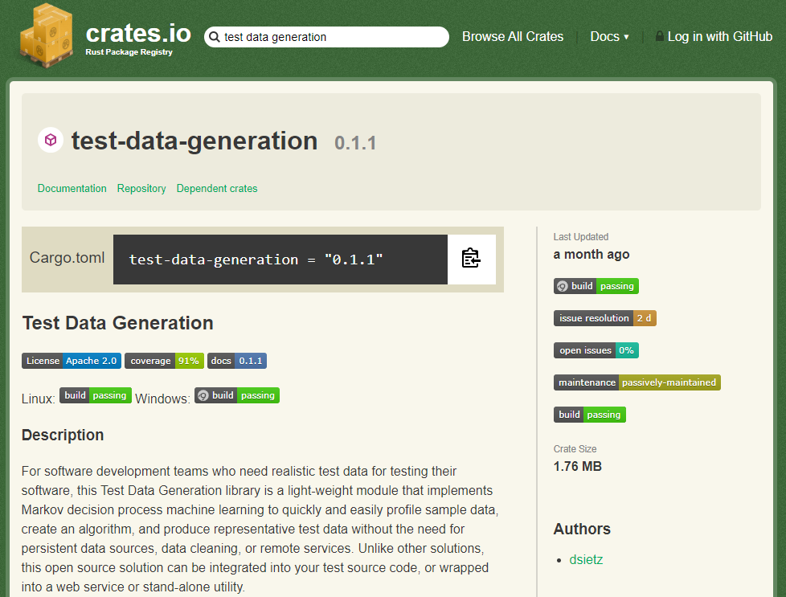
Test Data Generation

Slide 35
1
overview
2
Rust
3
Markov Decision Process
4
machine learning

Slide 36




Markov Decision Process (MDP)
Known back in the 1950s
MDP is a mathematical framework for building decision making models. Based on ...
partial
randomness
rewards
model
imagined environment

Slide 37
Markov Decision Process (MDP)
Part | Description
S | set of possible states to be in
A_{s} | set of available actions for a given state (s)
P_{a} | probability that given action (a) for given state (s) will lead to state (s’)
R_{a} | reward received for using action (a) to move from state (s) to state (s’)
Δ | discount factor for future rewards verses current rewards
What is the situation I’m currently in?
What can I do?
Should I do that?
I did it. Was it worth it?
If I were to do this all again, would I do it different?

Slide 38

Markov Decision Process (MDP)
Did kids come up with this framework?

Slide 39
Markov Decision Process (MDP)
10%
my teeth are brushed
need to brush my teeth
go brush
90%
question it
model
go brush
30%
Playing with my toys is more rewarding than brushing my teeth.
rethink brushing my teeth
70%
go play
playing with my toys

Slide 40
Markov Decision Process (MDP)
The Markovian Property lends itself to machine learning because the system doesn’t need past states for optimal decision, because current state incorporates everything necessary to make a good decision.
dynamic programming
reinforcement learning

Slide 41
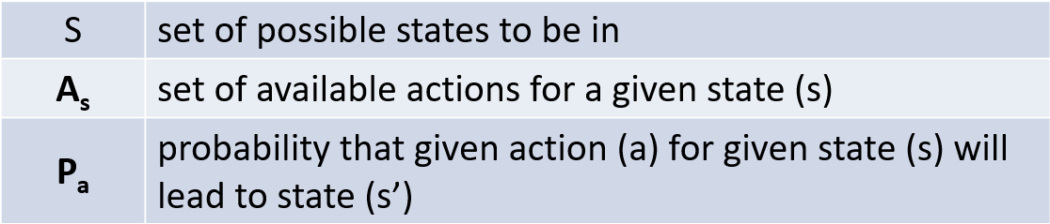
Markov Decision Process (MDP)
Part | Description
S | set of possible states to be in
A_{s} | set of available actions for a given state (s)
P_{a} | probability that given action (a) for given state (s) will lead to state (s’)
R_{a} | reward received for using action (a) to move from state (s) to state (s’)
Δ | discount factor for future rewards verses current rewards

Slide 42
Markov Decision Process (MDP)
state
S
m
i
t
i
fact
possible actions to take
i
e
o
t
t
pattern
probability of given actions
u
d
profile
model

Slide 43
analyzing
data sample
data sample parser
data algorithm
data sample parser
test data
data algorithm

Slide 44
facts
S
m
i
t
h
,
J
o
h
n
fact
fact
fact
fact
fact
attribute | value
key
prior key
next key
pattern placeholder
start with
ends with
index offset
`,`
@ = unknown
C = upper case consonant
c = lower case consonant
V = upper case vowel
v = lower case vowel
# = numeric digit
~ = special regex character
S = white space
p = punctuation
`h`
` `
p
0
0
5

Slide 45

patterns
S
m
i
t
h
,
J
o
h
n
pattern
fact
,
fact
,
fact
,
fact
entity
CcvccpSCvcc

Slide 46
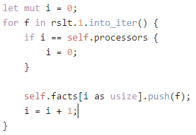
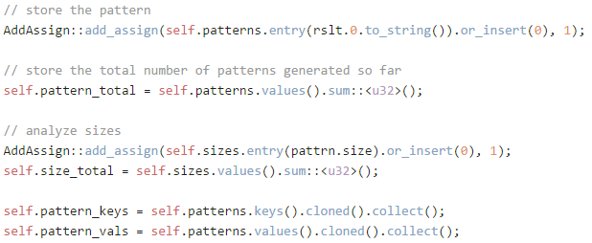
profiles
profile
processors
fact
,
fact
,
fact
,
fact
pattern | count
CvccvccpSCvccvv | 2
CvccvccpSCvccvc | 1
CvcvcccpSCcvcv | 1
CvcvpSCvccc | 1
V@CcvvcpSCvccc | 1
Total | 6
CcvccpSCvcc
1
7

Slide 47
profiles
(preparing patterns)
pattern | count | % freq | % cum
CvccvccpSCvccvv | 2 | 28.57 | 28.57
CcvccpSCvcc | 1 | 14.28 | 42.85
CvccvccpSCvccvc | 1 | 14.28 | 57.13
CvcvcccpSCcvcv | 1 | 14.28 | 71.41
CvcvpSCvccc | 1 | 14.28 | 85.69
V@CcvvcpSCvccc | 1 | 14.28 | 100
Total | 7 | 99.97
random number between 1 and 100
17
63

Slide 48

profiles
(preparing facts)
CcvccpSCvcc
Where …
S
m
pattern placeholder = v
prior key = m
doesn’t start or end
offset between 1 and 6
key | prior key | next key | pattern placeholder | starts with | ends with | index offset | count | % prob
i | m | t | v | 0 | 0 | 2 | 2 | 50%
o | m | o | v | 0 | 0 | 3 | 1 | 25%
u | m | m | v | 0 | 0 | 5 | 1 | 25%
… | … | … | … | … | … | ... | … | …

Slide 49
generation
data sample
data sample parser
data algorithm
data sample parser
test data
data algorithm

Slide 50
1
overview
2
Rust
3
Markov Decision Process
4
machine learning

Slide 51
Types of
Machine Learning
Supervised
Unsupervised
Semi-supervised
Reinforcement

Slide 52


Supervised
The human provides the computer with the input and the desired output
The computer builds relationships between the inputs and outputs so that it can predict outputs on its own
A ticket with a HIGH priority and of type DEFECT needs to be sent to the DEVELOPMENT
human expert
A ticket with a LOW priority and of type QUESTION needs to be sent to SUPPORT
computer
priority | type | route to
high | defect | development
low | question | support
medium | question | sales
A ticket with a MEDIUM priority and of type QUESTION needs to be sent to SALES
Notes:
Assumption that bulk processing is faster, but requires a timer which causes data latency

Slide 53





Supervised
development
computer
priority: low
type: question
priority: high
type: question
priority | type | route to
high | defect | development
low | question | support
medium | question | sales
support
sales
Notes:
Assumption that bulk processing is faster, but requires a timer which causes data latency

Slide 54


Unsupervised
There isn’t a human teaching the computer
The computer detects patterns in the data and learns these patterns so that it can predict outputs on its own
ticket:{
id: 1001,
owner: chatbot,
chat: “I have a serious
problem when I try
to login.”
}
listen to events
human expert
computer
ticket:{
id: 1001,
owner: chatbot,
chat: “I have a serious
problem when I try
to login.”
}
ticket 1001 chatbot serious
problem I login
event
broker
Notes:
Assumption that bulk processing is faster, but requires a timer which causes data latency

Slide 55
Unsupervised
There isn’t a human teaching the computer
The computer detects patterns in the data and learns these patterns so that it can predict outputs on its own
ticket:{
id: 1001,
owner: support,
chat: “Thanks. That fixed
it. I’m able to
login now.”
}
computer
ticket:{
id: 1001,
owner: support,
chat: “Thanks. That fixed
it. I’m able to login
now.”
}
ticket 1001 support Thanks
able I’m login
Therefore…
serious problem login
relates to chatbot and then support
event
broker
listen to events
Notes:
Assumption that bulk processing is faster, but requires a timer which causes data latency

Slide 56
Semi-supervised
Manual interpretation of the input data is “costly”
Self interpretation of input data is “uncertain”
Look for positive verses negative words, such as problem = negative, fixed = positive
human expert
Look for verbs that can be used to route tickets, such as try = support, purchase = sales
computer
discovery
Look for employee names to help route tickets, for example: John Jones = Development
Notes:
Assumption that bulk processing is faster, but requires a timer which causes data latency

Slide 57

Semi-supervised
ticket:{
id: 1001,
owner: chatbot,
chat: “I have a serious
problem when I try
to login.”
}
support
computer
ticket:{
id: 1001,
owner: chatbot,
chat: “I have a serious
problem when I try
to login.”
}
ticket 1001 chatbot serious
problem I try login
event
broker
listen to events
Notes:
Assumption that bulk processing is faster, but requires a timer which causes data latency

Slide 58

Reinforcement
Incorporates the results of the actions taken
Rewards actions with positive outcomes
Minimizes risk of preforming actions with negative outcomes
support
computer
ticket
discovery
Notes:
Assumption that bulk processing is faster, but requires a timer which causes data latency

Slide 59
Machine Learning
for Test Data Generation
Supervised
Unsupervised
Semi-supervised
Reinforcement

Slide 60
Machine Learning
for Test Data Generation
Semi-supervised
Reinforcement
Levenshtein Distance is the measurement of similarity between 2 strings, determined by the number of deletions, insertions, or substitutions to make them the same.
Discovery of possible states
Determines results of predicted output – using Levenshtein Distance
Discovery of possible actions based on states
Discovery of possible actions based on states
Probability of taking an action based on the current state
Markov Decision Process

Slide 61
1
overview
2
Rust
3
Markov Decision Process
4
machine learning

